Slide 1

Department of Computer Science, CUI Lahore Campus
Formal Methods in Software Engineering
By
Farooq Ahmad

Slide 2
Predicate Logic
Multiple Quantified statements, Pre and post conditions

Slide 3
Topics to be discussed
Multiple quantified statements
Pre and post conditions

Slide 4
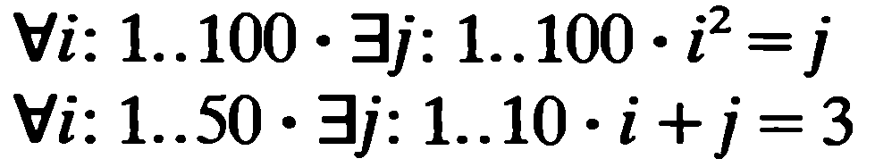
Multiple quantified statements
To show that such a statement is true, you must be able to meet the following challenge:
• Imagine that someone is allowed to choose any element whatsoever from the set D, and imagine that the person gives you that element. Call it x.
• The challenge for you is to find an element y in E so that the person’s x and your y, taken together, satisfy property P(x, y).

Slide 5
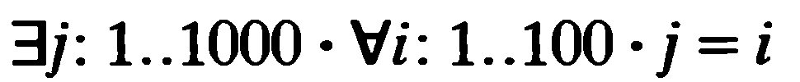
Multiple quantified statements
To show that a statement of this form is true:
You must find one single element (call it x) in D with the following property:
• After you have found your x, someone is allowed to choose any element whatsoever from E. The person challenges you by giving you that element. Call it y.
• Your job is to show that your x together with the person’s y satisfy property P(x, y).

Slide 6
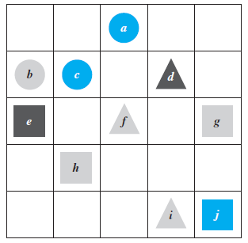
Example
Show that the following statement is true in this world:
For all triangles x, there is a square y such that x and y have the same color.
There is a triangle x such that for all circles y, x is to the right of y.

Slide 7
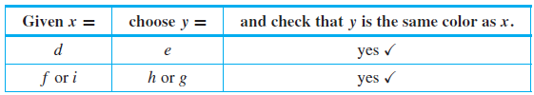
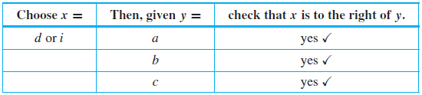
Solution

Slide 8
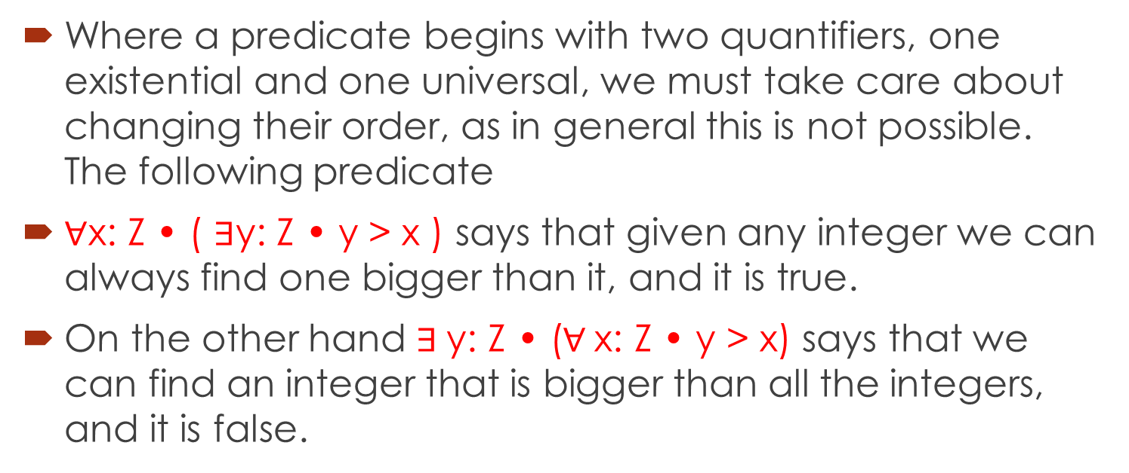
Mixing quantifiers
Where a predicate begins with two quantifiers, one existential and one universal, we must take care about changing their order, as in general this is not possible. The following predicate
$∀$x: Z • ( $∃$y: Z • y > x ) says that given any integer we can always find one bigger than it, and it is true.
On the other hand $∃$y: Z • ($∀$x: Z • y > x) says that we can find an integer that is bigger than all the integers, and it is false.

Slide 9
Predicate calculus and design specification
During system design a functional specification is transformed into a system design.
Such a design will consist of a series of discrete units.
In turn these units will consist of modules which contain procedures and functions which are related by virtue of the tasks they perform.

Slide 10
Pre and post condition
Using slightly augmented form of the predicate calculus, it is relatively straightforward to construct precise functional specifications of the program units.
Such specifications will consist of two predicates. The first is called a pre-condition. It relates the values of global variables and parameters before a program unit is executed.
The second predicate is called a post-condition. It relates the values of global variables and parameters after a program unit has been executed.

Slide 11
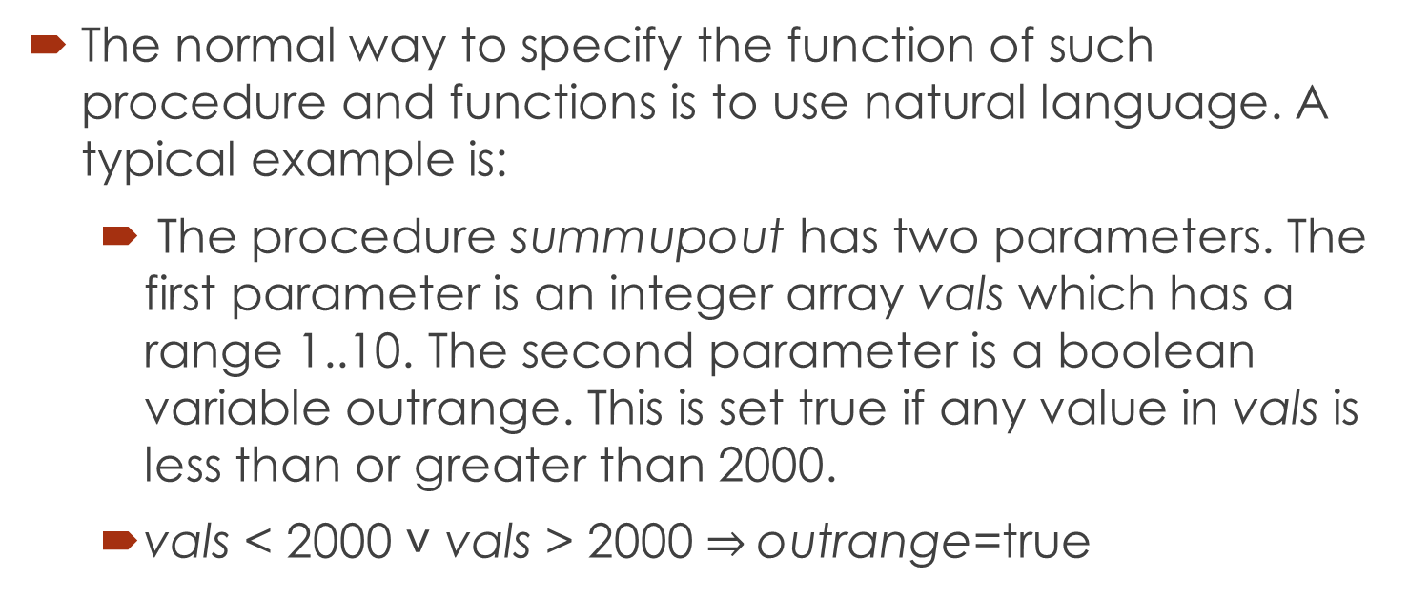
Example
The normal way to specify the function of such procedure and functions is to use natural language. A typical example is:
The procedure summupout has two parameters. The first parameter is an integer array vals which has a range 1..10. The second parameter is a boolean variable outrange. This is set true if any value in vals is less than or greater than 2000.
vals < 2000 ˅ vals > 2000 $⇒$outrange=true

Slide 12
Example
The function of the update procedure is to update the value of the global variable systemstate. The procedure has one integer parameter temp.
Post-condition: If temp is greater or equal to 200, then systemstate is set to zero; otherwise system state is set to a value of one.
Pre-condition: systemstate will have a value ranging between zero and five, temp will range from zero to 1000. temp will be unaffected by the procedure.

Slide 13
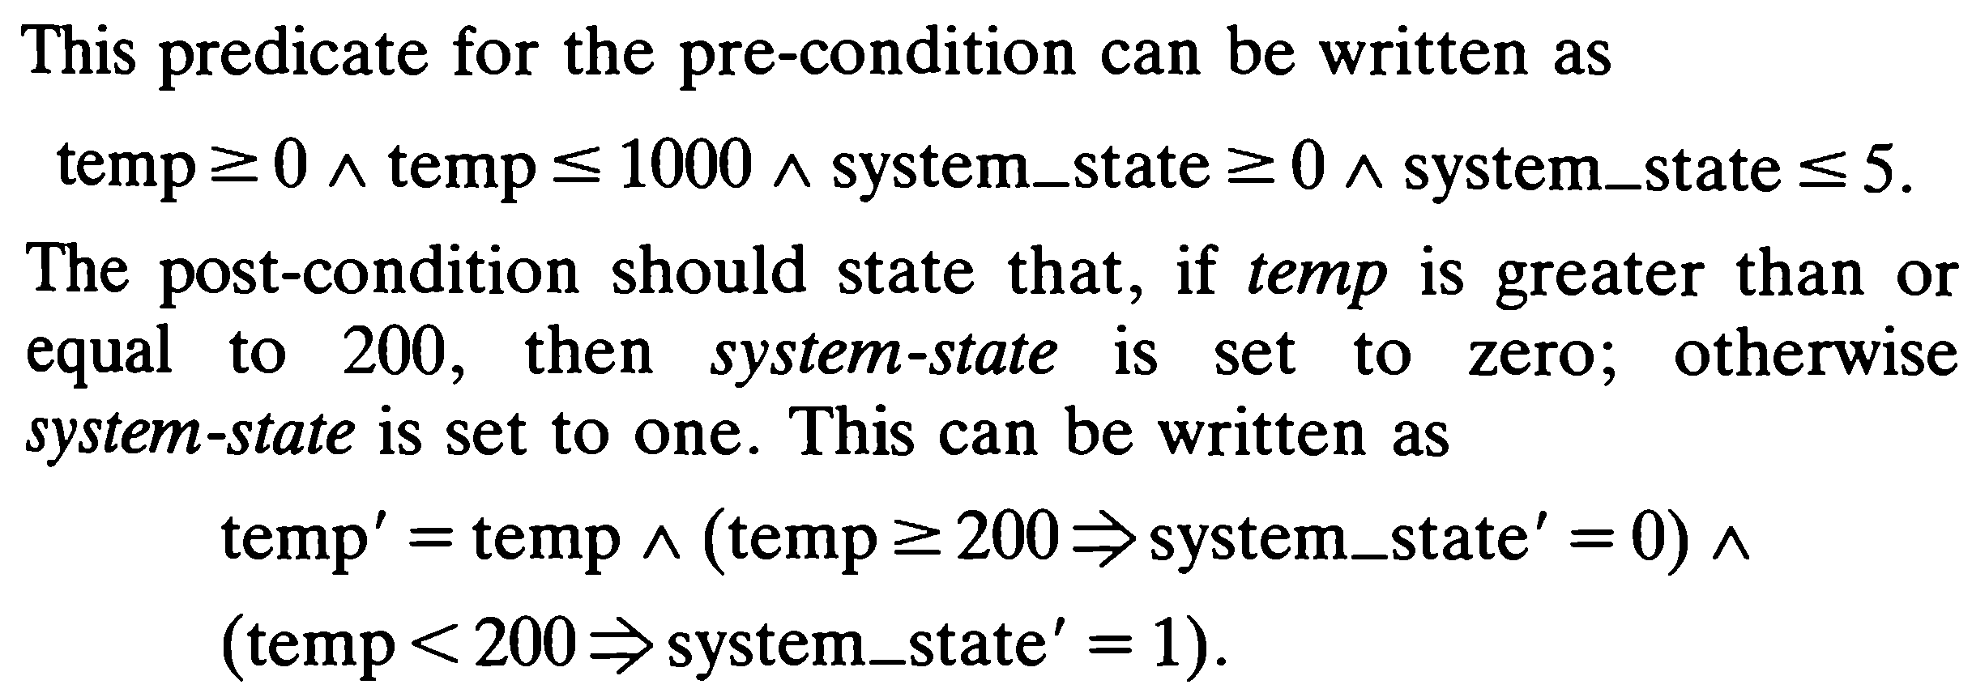
Solution
The primes over a variable indicate the value of the variable after a program unit has been executed.

Slide 14
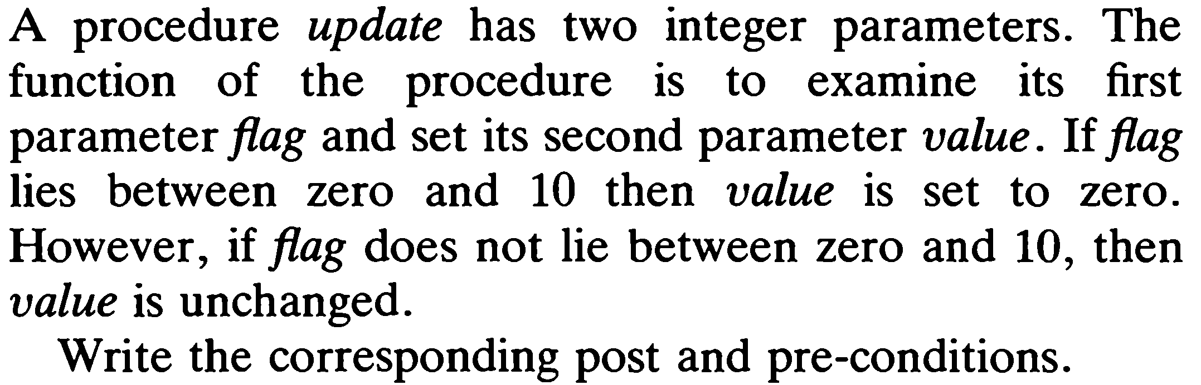
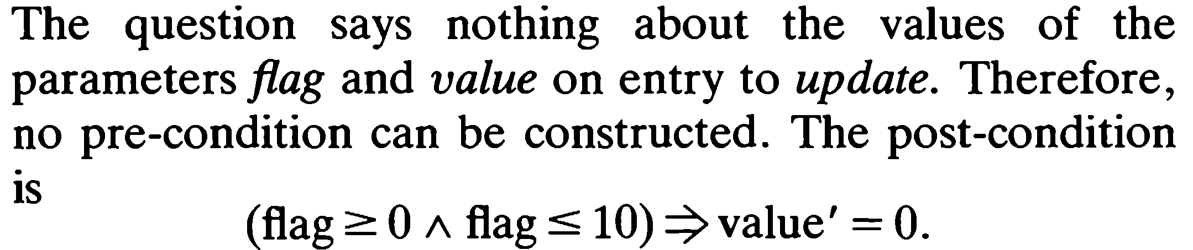
Example

Slide 15
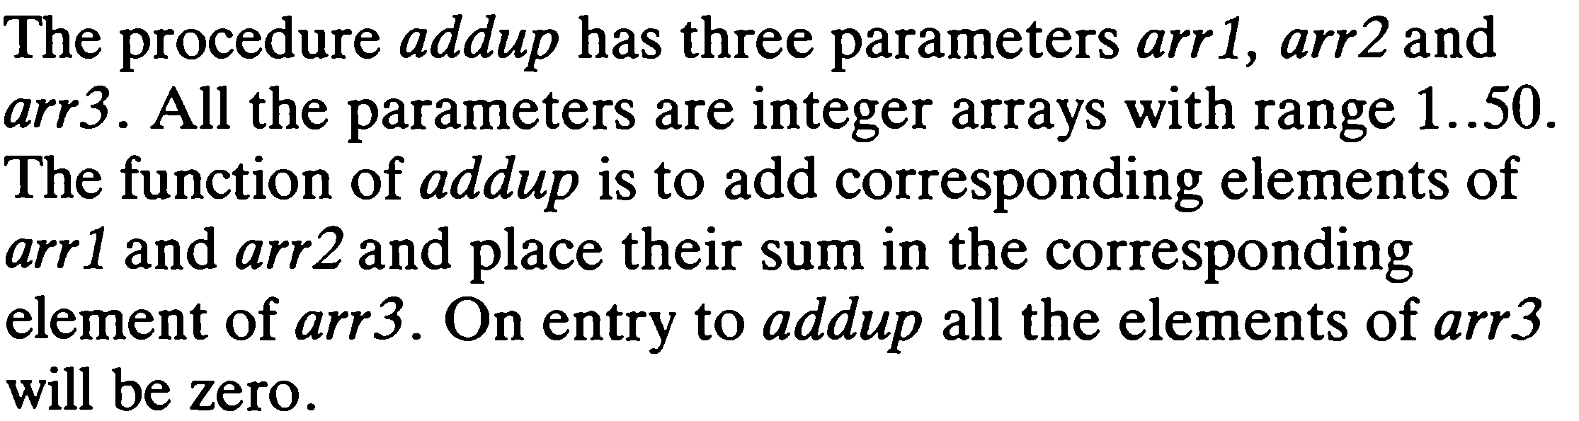
Example with quantification

Slide 16
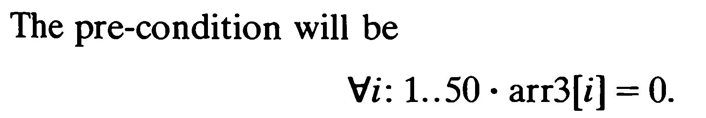
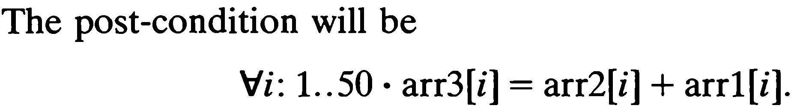
Solution

Slide 17
Summary of the lecture: conclusion
Multiple quantified statements
Truth value of multiple quantified statements
Pre and post conditions

Slide 18
Reference and reading material
Chapter # 3: Section 3.3 of the book “Software development with Z” by J.B. Wordsworth
Chapter # 2: of the book “Formal Software Development, from VDM to Java” by Quentin Charatan and Aaron Kans

